Slide 1

8th Grade Math: Pre-Algebra
Unit 14, Lesson 6 Applying Proportional Reasoning to Probability Volume 2, pg. 337

Slide 2


Benchmark
MA.8.DP.2.3
Solve real-world problems involving probabilities related to single or repeated experiments, including making predictions based on theoretical probability.
volume 2, pg. 337

Slide 3
Integrated Mathematical Thinking and Reasoning Standards
MA.K12.MTR.3.1 Complete tasks with mathematical fluency.
MA.K12.MTR.5.1 Use patterns and structure to help understand and connect mathematical concepts.
volume 2, pg. 337

Slide 4

Learning Targets
I can use proportional reasoning to make a prediction based on theoretical probability.
I can use the probability of an experiment to determine the sample space.
volume 2, pg. 337

Slide 5

Warm-Up
volume 2, pg. 338

Slide 6
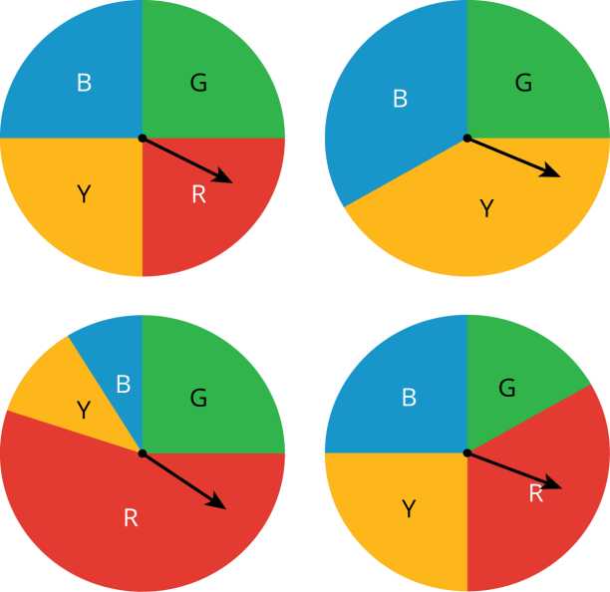
14.6.1 Warm-Up: Proportionality
Four spinners are shown. Explain which spinner doesn’t belong.
volume 2, pg. 338

Slide 7

Exploration
volume 2, pg. 338

Slide 8


14.6.2 Exploration: Increasing Sample Space
Work with your partner to complete the following.
A deck of cards is shown.
Deck A:
If a game is played in which a card is drawn from Deck A, what is the probability of drawing a card that is not blue?
volume 2, pg. 338

Slide 9

Consider Deck B.
Deck B:
What is the probability of drawing a card that is not blue from Deck B?
volume 2, pg. 338

Slide 10

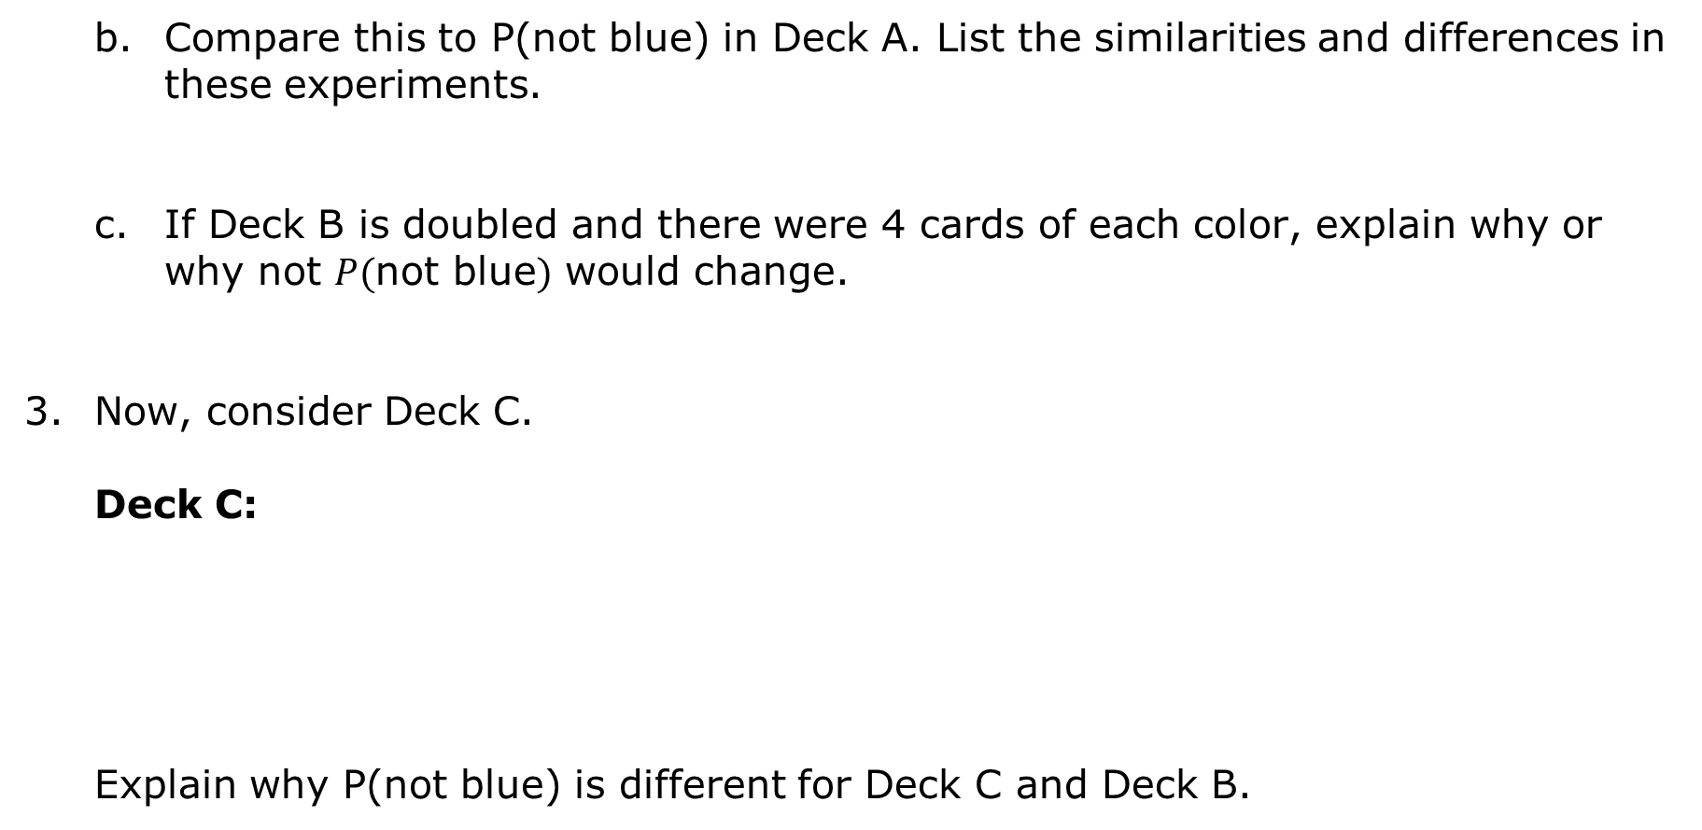
Compare this to P(not blue) in Deck A. List the similarities and differences in these experiments.
If Deck B is doubled and there were 4 cards of each color, explain why or why not $P($not blue$)$ would change.
Now, consider Deck C.
Deck C:
Explain why P(not blue) is different for Deck C and Deck B.
volume 2, pg. 339

Slide 11
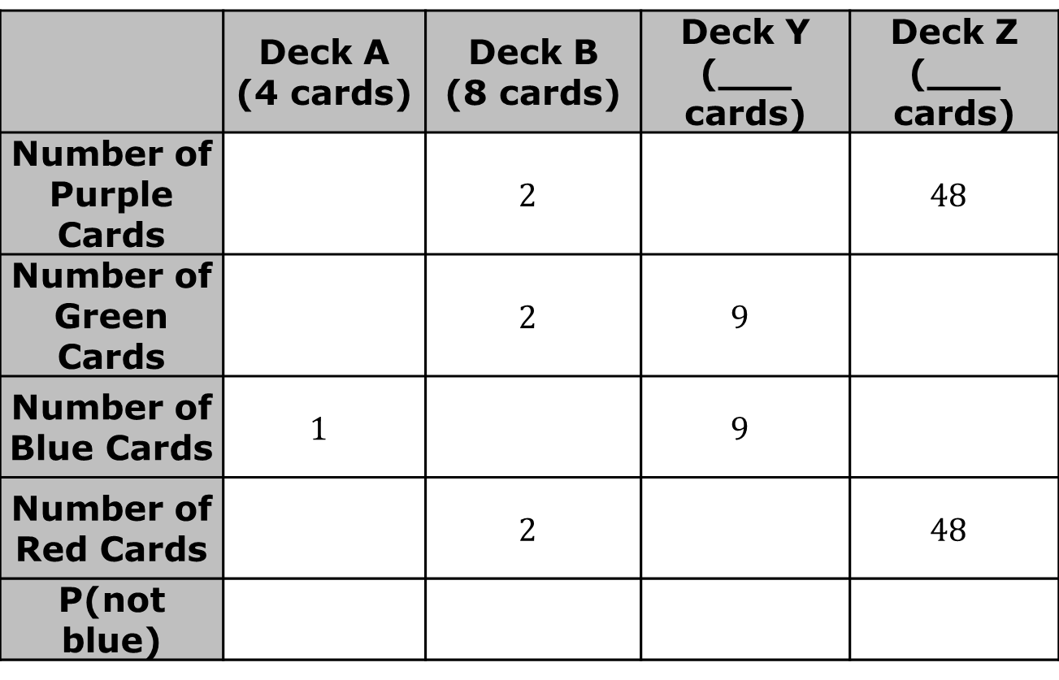
Complete the table by increasing the size of Deck A without changing the probabilities of any colors.
 | Deck A (4 cards) | Deck B (8 cards) | Deck Y (___ cards) | Deck Z (___ cards)
Number of Purple Cards |  | $$2$$ |  | $$48$$
Number of Green Cards |  | $$2$$ | $$9$$
Number of Blue Cards | $$1$$ |  | $$9$$
Number of Red Cards |  | $$2$$ |  | $$48$$
P(not blue)
volume 2, pg. 339

Slide 12
Summarize the strategy you used to complete the table.
volume 2, pg. 339

Slide 13

Collaboration
volume 2, pg. 340

Slide 14

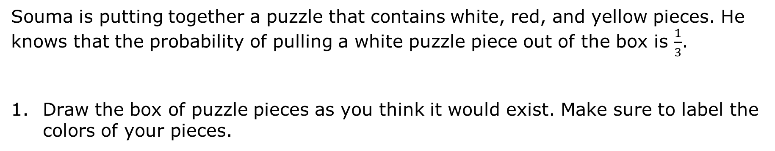
14.6.3 Collaboration: Puzzle Proportions
Souma is putting together a puzzle that contains white, red, and yellow pieces. He knows that the probability of pulling a white puzzle piece out of the box is $\frac{1}{3}$.
Draw the box of puzzle pieces as you think it would exist. Make sure to label the colors of your pieces.
volume 2, pg. 340

Slide 15
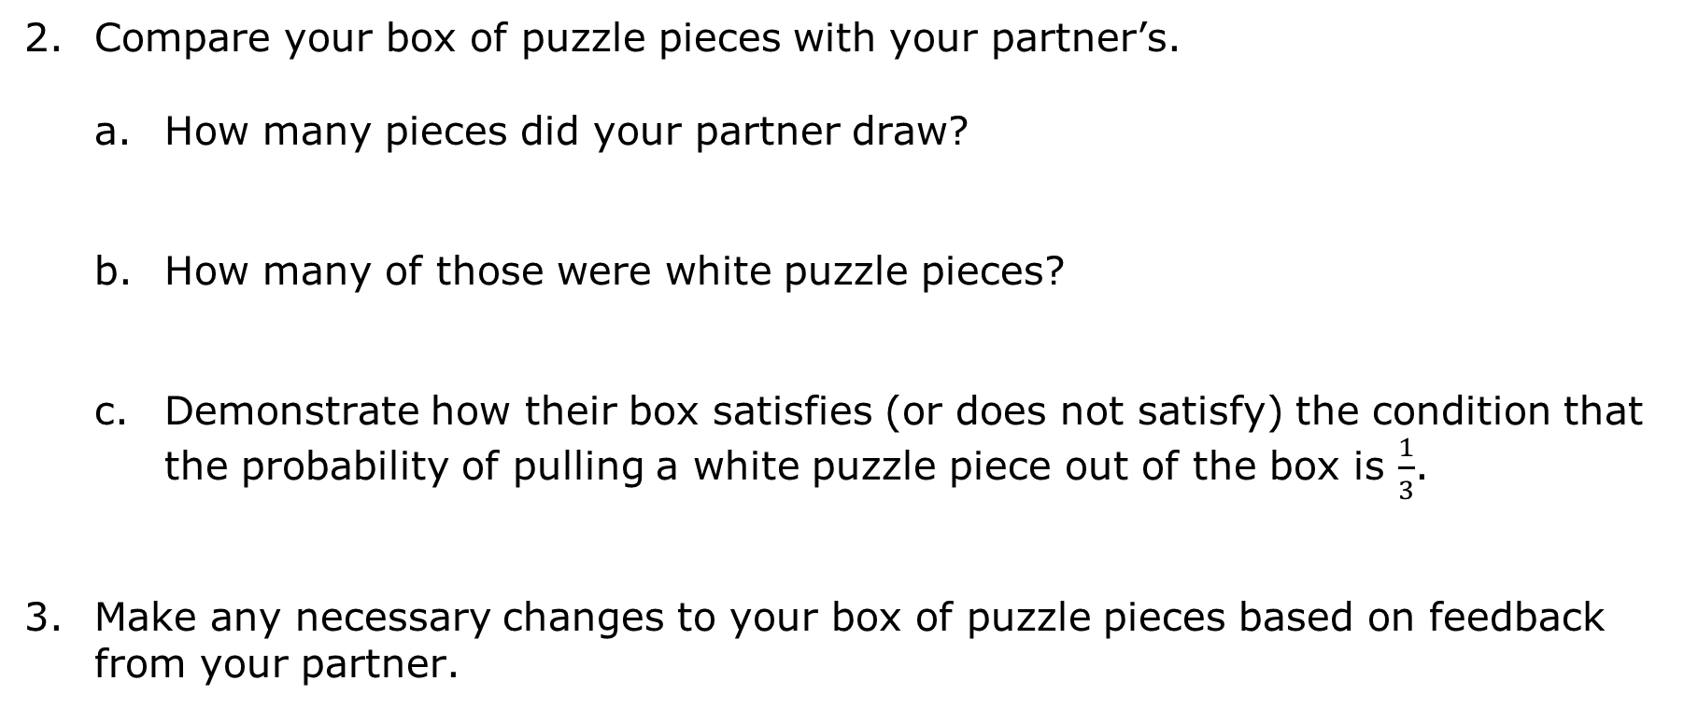
Compare your box of puzzle pieces with your partner’s.
How many pieces did your partner draw?
How many of those were white puzzle pieces?
Demonstrate how their box satisfies (or does not satisfy) the condition that the probability of pulling a white puzzle piece out of the box is $\frac{1}{3}$.
Make any necessary changes to your box of puzzle pieces based on feedback from your partner.
volume 2, pg. 340

Slide 16

Souma counts his puzzle pieces and determines that there are $60$ pieces. If $P(white)= \frac{1}{3}$and $P(red)=0.6$, then …
...how many red pieces are in his puzzle box?
...how many yellow pieces are in his puzzle box?
volume 2, pg. 340

Slide 17

Bring It Together
volume 2, pg. 341

Slide 18


14.6.4 Bring It Together: Probability Distributions
Complete the following probability distribution so that it is valid.
Selecting clothing items from a hamper of mixed items that includes dresses, t-shirts, leggings, and shorts containing 30 items.
For a probability distribution to be valid, each probability must be a number between 0 and 1 and the sum of each outcome’s probabilities must equal 1.
volume 2, pg. 341

Slide 19
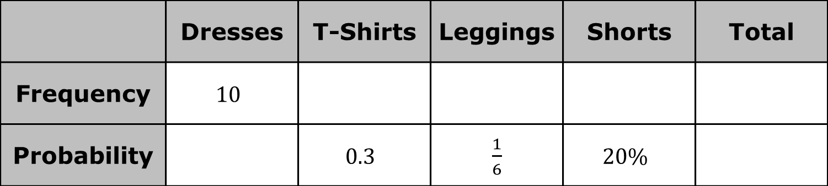
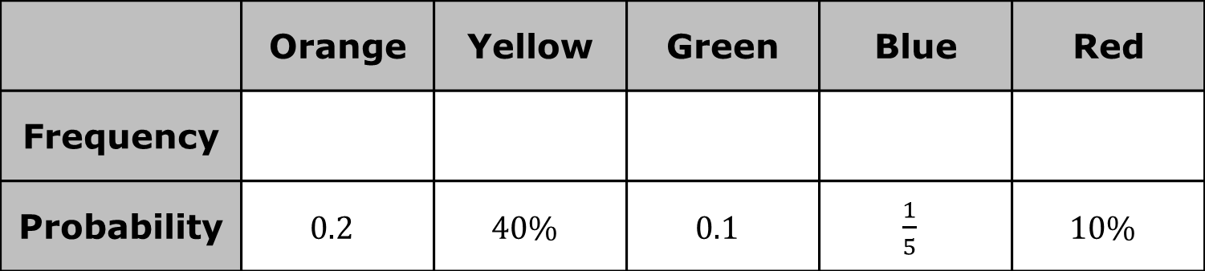
Zareen has a bag of 10 sour candies. The bag consists of orange, yellow, green, blue, and red candies. Complete the table by using probability to determine how many candies of each color are in Zareen’s bag.
 | Dresses | T-Shirts | Leggings | Shorts | Total
Frequency | $$10$$
Probability |  | $$0.3$$ | $\frac{1}{6}$ | $$20\%$$
 | Orange | Yellow | Green | Blue | Red
Frequency
Probability | $$0.2$$ | $$40\%$$ | $$0.1$$ | $\frac{1}{5}$ | $$10\%$$
volume 2, pg. 341

Slide 20

Try It
volume 2, pg. 341

Slide 21

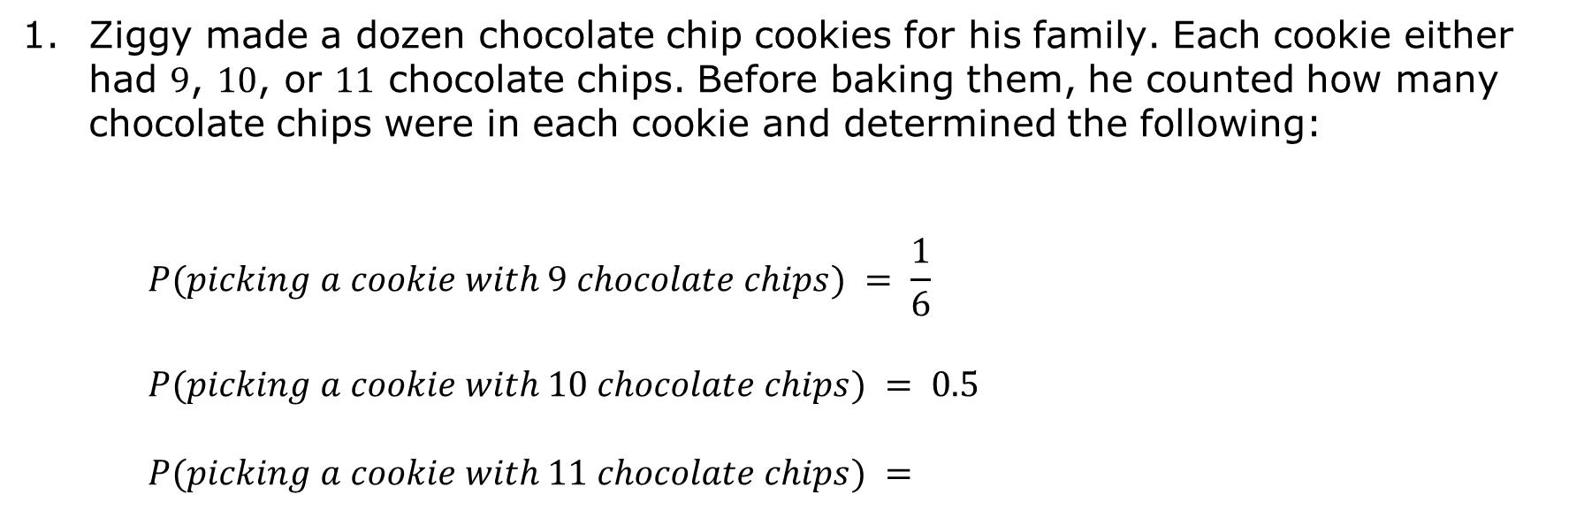
14.6.5 Try It: Determining Sample Space
Ziggy made a dozen chocolate chip cookies for his family. Each cookie either had 9, 10, or 11 chocolate chips. Before baking them, he counted how many chocolate chips were in each cookie and determined the following:
$$P(picking a cookie with 9 chocolate chips) = \frac{1}{6}$$
$$P(picking a cookie with 10 chocolate chips) = 0.5$$
$$P(picking a cookie with 11 chocolate chips) =$$
volume 2, pg. 341

Slide 22
Ziggy forgot to calculate the probability of selecting a cookie with 11 chocolate chips. Explain how he can use the two probabilities he already calculated to determine the missing probability.
What is the probability of choosing a cookie with 11 chocolate chips?
volume 2, pg. 341

Slide 23
How many cookies have exactly 9 chocolate chips?
How many cookies have exactly 10 chocolate chips?
How many cookies have exactly 11 chocolate chips?
Construct a probability distribution to check your work.
volume 2, pg. 342

Slide 24

Your Turn
volume 2, pg. 342

Slide 25
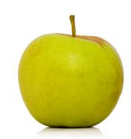
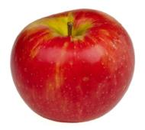
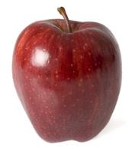
14.6.6 Your Turn!
A grocery store is giving away gift cards to customers who can correctly estimate the number of green apples in a bag of 25 apples. The sign states the following:
P(Granny Smith)= 0.2
P(Honeycrisp)= 0.32
P(Red Delicious)= 0.48
volume 2, pg. 342

Slide 26
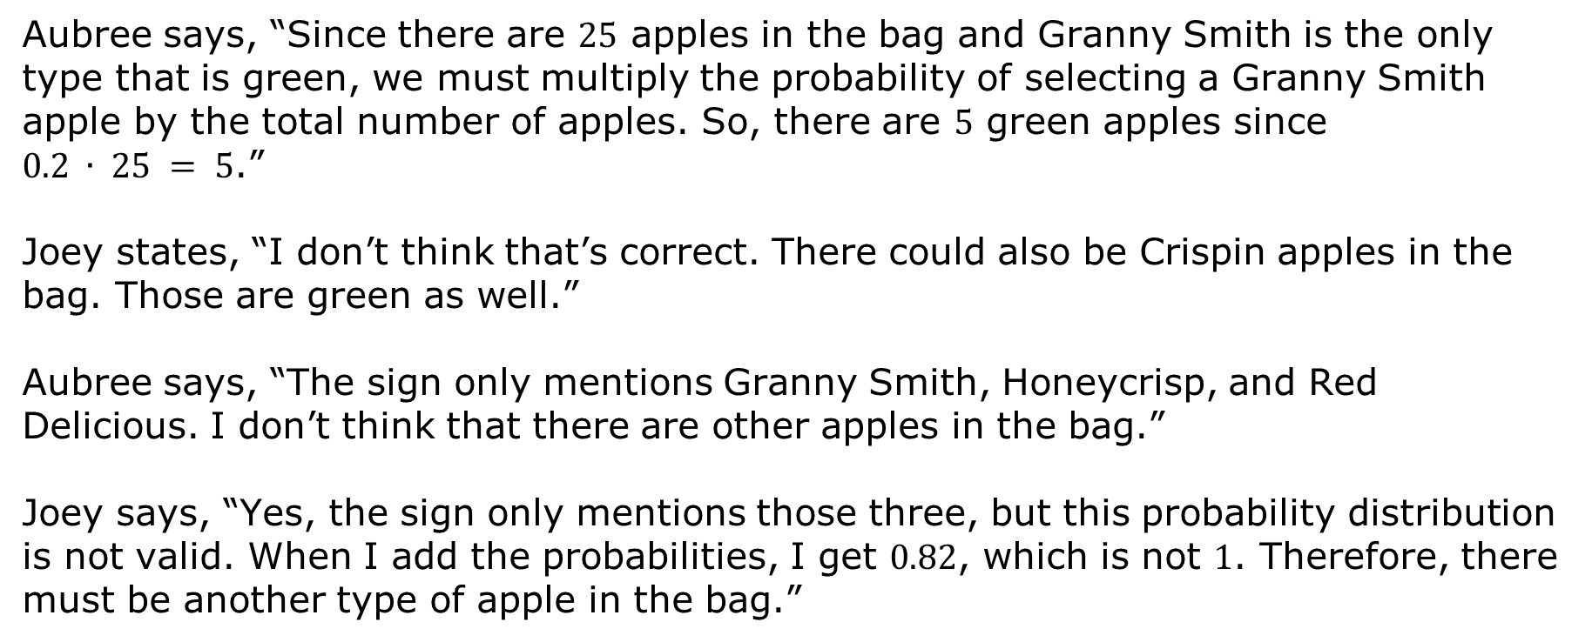
Aubree says, “Since there are 25 apples in the bag and Granny Smith is the only type that is green, we must multiply the probability of selecting a Granny Smith apple by the total number of apples. So, there are 5 green apples since $0.2 ∙ 25 = 5$.”
Joey states, “I don’t think that’s correct. There could also be Crispin apples in the bag. Those are green as well.”
Aubree says, “The sign only mentions Granny Smith, Honeycrisp, and Red Delicious. I don’t think that there are other apples in the bag.”
Joey says, “Yes, the sign only mentions those three, but this probability distribution is not valid. When I add the probabilities, I get 0.82, which is not 1. Therefore, there must be another type of apple in the bag.”
volume 2, pg. 342

Slide 27
Explain who made an error in their calculations.
What is the correct number of green apples in the bag?
Calculate the number of Honeycrisp apples in the bag.
Calculate the number of Red Delicious apples in the bag.
volume 2, pg. 343

Slide 28

Wrap-Up
volume 2, pg. 343

Slide 29
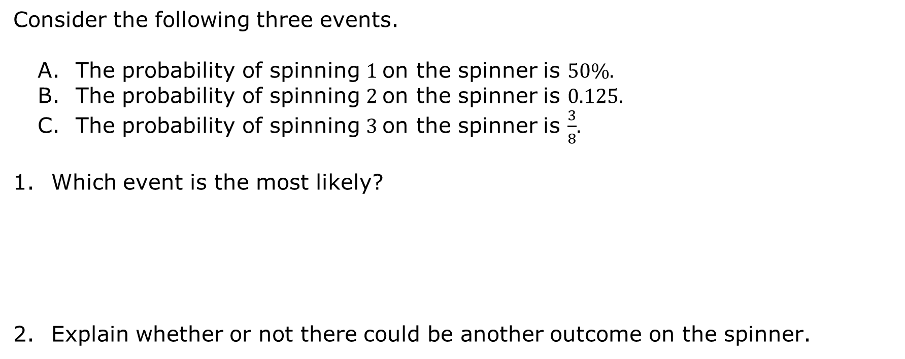
14.6.7 Wrap-Up: Cool Down
Consider the following three events.
The probability of spinning 1 on the spinner is 50%.
The probability of spinning 2 on the spinner is 0.125.
The probability of spinning 3 on the spinner is $\frac{3}{8}$.
Which event is the most likely?
Explain whether or not there could be another outcome on the spinner.
volume 2, pg. 343

